Slide 1

Smart Cradle System
Project Guide:
M. Vani Pujitha,M.Tech
Assistant Professor
Department of CSE
Team Members (BATCH-14):
208W5A0516- P.Harika
208W5A0517- T.Chihnitha
198W1A05I8- V. Chaitanya

Slide 2
Abstract
In this technical world, many parents find a hard time to take care of their children as they are busy with their jobs and all their other work. Many people think that taking care of the baby is the duty of the mother only. But it will be a very burden for the mothers to do all the household work and their job and also take care of the baby on the other hand. So, for people who believe in technology, this is a smart cradle that will be connected to the mobile of the parents. This system will help the parents to take care of their babies even from a long distance. This system is built based on the 4 parameters. They are wetness, motion, temperature and humidity, and live streaming of the baby. Here DHT11 sensor is used to detect any temperature increase in the room and baby movement is detected by the IR sensor and live streaming will be provided by the esp32 camera. GSM module is also used to send alert messages and calls to the parents if any uncertainty is found with the baby and here will be automatic swinging also be added. This proposed system will decrease the burden on the parents and also helps to make the baby safe without any discomfort and give relief to the parents.
Keywords: Wetness Sensor, IR sensor, Temperature and humidity Sensor, Smart Cradle, GSM Module,ESP32 cam

Slide 3
Problem statement & Motivation &Scope
.
Problem Statement
Scope
Taking care of the child is considered as the responsibility of mother solely. It is difficult for women to manage both work and home. More burden on women as a mother. Most of the mothers struggled more with baby cry. Baby stress increased if instant taking care is not taken. Disturbance during cooking and office work.
• This project is limited only for monitoring babies using alert messages.
• This device is designed for house hold application.
• To use this system we need a proper network.
Motivation
• It is very hard for nurses to handle more babies at a time.
• 27 percent of mothers struggled more with baby cry.
• 71 percent of mothers said lack of sleep is the hardest of having a newborn.
• Stressed baby: Baby stress increased if instant taking care is not taken.

Slide 4
Objectives & Areas Visited & Advantages
.
Objectives
Advanatages
• To implement a cradle that help nurses to handle more than one baby at a time.
• To implement a cradle that help mothers personally to take care of the baby in their residence.
• This system will alert the mother/guardian through SMS.
• To provide proper safety for babies.
•It has easy interface and the cradle can be operated by GSM messages.
• Due to smart cradle parents get free time and any unusual activity of the baby will send alert message to parents.
• Live streaming of the baby will be provided.
Areas Visited
• Tadigadapa
• Kanuru

Slide 5

Photo with Client
.
Client Details:
Client name: Dr. P. USHA LATHA ,MD(OB & G)
Consultant Gynaecologist
Place : Time Hospitals,
M.G. Road , Vijayawada

Slide 6
LITERATURE SURVEY[1]
Title : Internet of Things-Based Baby Monitoring System for Smart Cradle
Journal: Institute of Electrical and Electronics Engineers(IEEE)-12 July 2019
Methodology : This system includes sensors to monitor the baby's vital parameters, such as temperature, moisture, and crying . The system architecture consists of a baby cradle that will automatically swing using a motor when the baby cries. Parents can also monitor their babie’s condition through an external web camera and switch on the lullaby toy located on the baby cradle remotely.
Advantages:
1.Monitoring the baby remotely.
Disadvantages:
1.The parents can type the set IP address for the IP camera in the network browser to monitor the baby’s conditions in real time.
2.Need to replace the soft plastic material in place of wood.

Slide 7
LITERATURE SURVEY[2]
Title : Wearable Sleep care Kit: Analysis and Prevention of Sleep Apnea Symptoms in Real-Time
Journal: Institute of Electrical and Electronics Engineers(IEEE)-March 2019
Methodology: This is a Sleep care Kit, an integrated wearable device. Bio-cradle continuously measures/stores multiple bio-signals and analyzes the signal data to determine sleep quality and emergency situation in real-time. it can inform the wearer or guardian about the danger through the smartphone or smart-speaker.
Advantages:
1. pre determines the risk of sleep apnea
2. 24 hours real time monitoring
Disadvantages:
1. It must include feature that can resolve apnea without interrupting the patient’s sleep when apnea occurs.

Slide 8
LITERATURE SURVEY[3]
Title : Development of an IoT based Smart Baby Monitoring System with Face Recognition
Journal: Institute of Electrical and Electronics Engineers(IEEE)- may 2021
Methodology :This is a a very efficient and user-friendly technology to implement automatic swinging of the baby bassinet with sound detection of the baby crying using sound sensor and playing lullaby through speakers. The humidity sensor has been used to know the diaper's moisture level, and notifications have been sent to parents with certain conditions through mobile calls and text messages.
Advantages:
1. helps in real time monitoring of the baby using face recognition.
Disadvantages:
1. It will be some hard to identify the face of baby every time.

Slide 9
LITERATURE SURVEY[4]
Title : An enhanced noise cancelling system for a comprehensive monitoring and control of baby environments
Journal: : Institute of Electrical and Electronics Engineers(IEEE)- march 2015
Methodology : This system enhanced noise cancelling system for a comprehensive monitoring and control to overcome the sound pollution and make the baby rooms more comfortable with all existing features.
Advantages:
1. helps the baby to sleep comfortably without any disturbance.
Disadvantages:
1.can show some effect on babies because the cancelling system may produce some signals.

Slide 10
LITERATURE SURVEY[5]
Title : Design and development of a smart baby monitoring system based on Raspberry Pi and Pi camera
Journal : Institute of Electrical and Electronics Engineers(IEEE) -January 2018
Methodology : This project presents a baby monitoring system for busy parents so that they can ensure the proper care and safety of their babies. This system can detect the baby's motion and sound; especially crying and video output of baby's present position can be displayed on a display monitor so that the mother or another responsible person can watch the baby while away from him or her. This baby monitoring system is capable of detecting motion and crying condition of the baby automatically.
Advantages:
1. The present work reduces the human effort and particularly mother’s stresses in working times.
Disadvantages:
1.This equipment will be more cost.

Slide 11
LITERATURE SURVEY[6]
Title : Central Real-time Monitoring System for Premature Baby Incubator
Journal: Institute of Electrical and Electronics Engineers(IEEE) - February 2021
Methodology : It is of great importance to provide a neutral temperature environment that is conducive to the growth and development of the premature babies, who have a small age and low weight and therefore are prone to have various growth and development problems. This paper designs a central real-time monitoring system for premature baby incubator by taking environmental temperature control as the main entry point. The incubator collects environment data by using temperature and humidity sensors and web cameras.
Advantages:
1. The incubator can effectively reduce the probability of medical accidents and safeguard the healthy growth of premature babies.
Disadvantages:
1.Not always handy.

Slide 12
LITERATURE SURVEY[7]
Title : Rocking Motion of the Baby Sleeping on the Mother’s Lap: Modeling and Prototype Automatic Swing Cradle Design
Journal: Institute of Electrical and Electronics Engineers(IEEE)-April 2017
Methodology : This system is designed to experience the motion that the mother made while sleeping her baby on the lap, and a cradle designed to repeat mother movements based on this model. A doll was given to the subjects and it was requested that to perform a baby rocking motion on their lap for 10 seconds.
Advantages:
1. Baby feels comfortable as they experience the feeling of their mother’s lap.
Disadvantages:
1. this system is designed by considering only the cry of the baby but mother cannot know why the baby is crying .

Slide 13
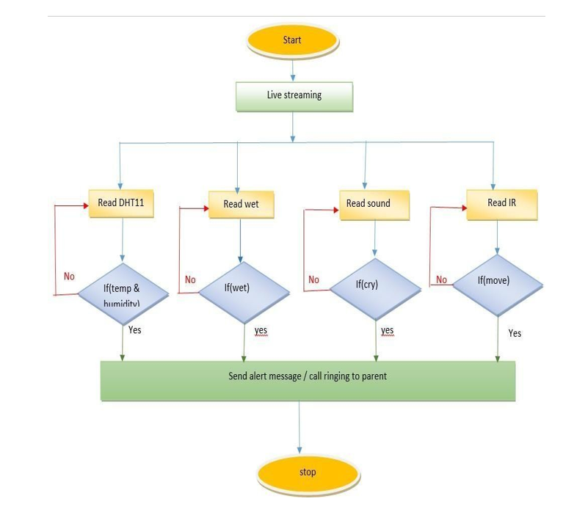
Proposed system
.

Slide 14
Modules & Algorithms
Algorithm 4.1: Automatic cradle swing
As the cradle is connected to the internet, if any movement is detected then the alert message or call will be sent to the parents indicating that their baby is crying.
Step 1: Begin
Step 2: Check whether the baby crying in the cradle
Step 3: check whether the movement is detected ifdetected, then send a message alert, call the parent,and the cradle will start swinging automatically.
Algorithm 4.2: Wetness Detection
A wetness sensor is used to detect if there is any wetness on the bed. If any hygiene is detected then this system will provide a message to the parents. If not then continue checking.
Step 1: Begin
Step 2: Check if a bed is wet in the cradle
Step 3: check whether moisture content is present if present then sends a message alert to the parent.
Step 4: after checking if there is no moisture then continue checking

Slide 15
Modules & Algorithms
Algorithm 4.3: Temperature And Humidity
DHT11 sensor is used for detecting the temperature. If any increase in temperature then the notification will be sent to the parents and also call will be sent.
Step 1: Begin
Step 2: Check whether the temperature in thesurroundings is increases
Step 3: If the temperature change is detected thensend an SMS alert, and call the parent.
Step 4: If no continue checking.
Algorithm 4.4: IR sensor
For the detection of the motion of the baby, IR sensor will be used. If any movement is detected then a message alert and call will be sent to the parents.
Step 1: Begin
Step 2: Check whether any movement of the baby in the cradle is detected.
Step 3: If any movement is observed then send a message alert, and call the parent.
Step 4: If there is no movement detection thencontinues checking.

Slide 16
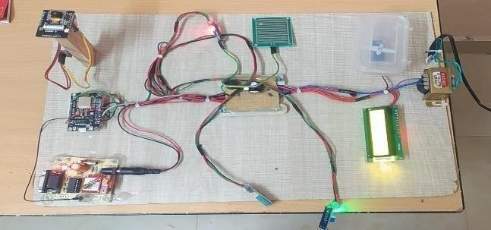
Results& Analysis
At first, the initial system displays a smart cradle system. Sometimes it may delayor can’t respond correctly. In such cases try to restart the system until the systemworks correctly. After the system responds correctly, the system gives continuoustemperature and wetness values on the LCD. Here Liquid Crystal Display (LCD) is the main output component. The system remains idle and gives only LCD outputs of temperature and wetness values until it finds any uncertain conditions occur. Here are uncertain conditions in the sense if any sudden change in temperature,
any wetness detection i.e value increases more than 50, and any movement by thebaby in the cradle is detected. In such cases, alert messages will be sent to the parents. In necessary conditions, a call alert will also be sent.

Slide 17
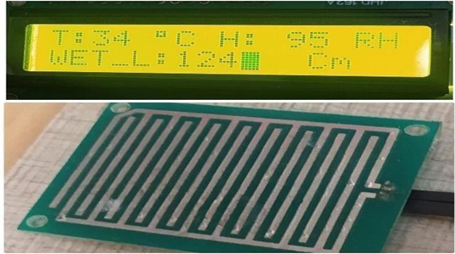
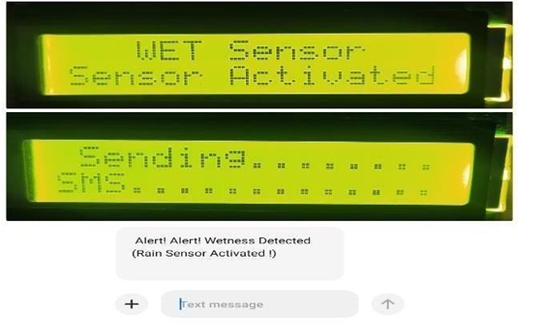
Results& Analysis
Now let us consider the wetness sensor, the wetness sensor is connected to Node MCU and the GSM module. If suddenly the wetness is detected, then the system responds and sends the alert message to the parents. As the babies feel discomfort if their bed is wet which may lead to the baby waking. So this system makes the parents respond fast when they get the alert message.

Slide 18
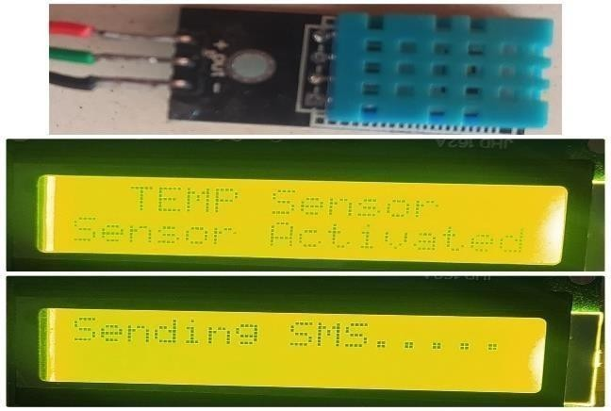
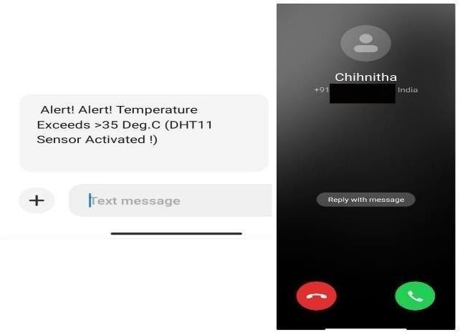
Results& Analysis
The DHT11 sensor is used for temperature and humidity detection. This sensor gives the continuous monitoring of the baby’s room temperature. Infants need to be survived at a minimum temperature. So if the temperature reaches greater than 35 degrees then an alert message and call will be sent to the parents.

Slide 19
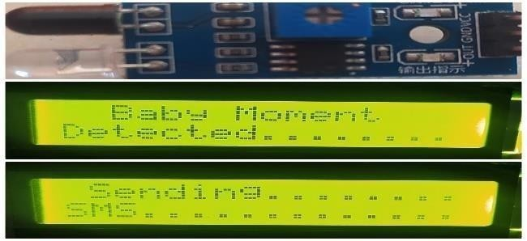
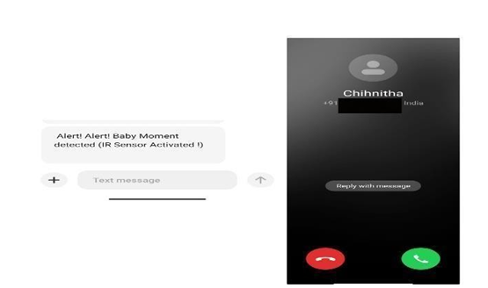
Results& Analysis
In the third case, an IR sensor is used to detect the movement of the baby. IR sensor is always active. If the IR sensor detects any movement in the cradle then the cradle starts swinging and sends the alert message and call to the parents. The system also responds by the automatic swinging of the cradle indicating that the movement detected in the cradle is that the baby is crying.

Slide 20
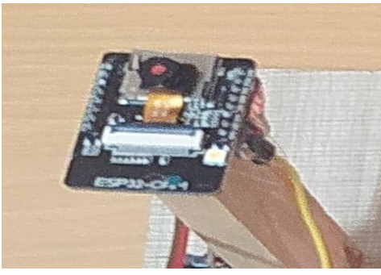
Results& Analysis
The other feature is that camera live streaming. The live streaming of the baby is given using ESP32 camera. The ESP32 camera is connected to desktop/ laptop using USB cable and then open the arduino IDE and select the port and open serial monitor and reset the GSM module. When ever the wifi is connected with specific username and password then the serial monitor tries to detect the ip and then it shows the ip address. Now open the Blynk IOT in your desktop/laptop and signup and login. Now create new project and setup the vedio streaming ESP32 camera. Then click on the vedio streaming window enter the ip address that isdisplayed in the serial monitor, return back to the previous window then click on play button.The vedio streaming will be displayed.

Slide 21
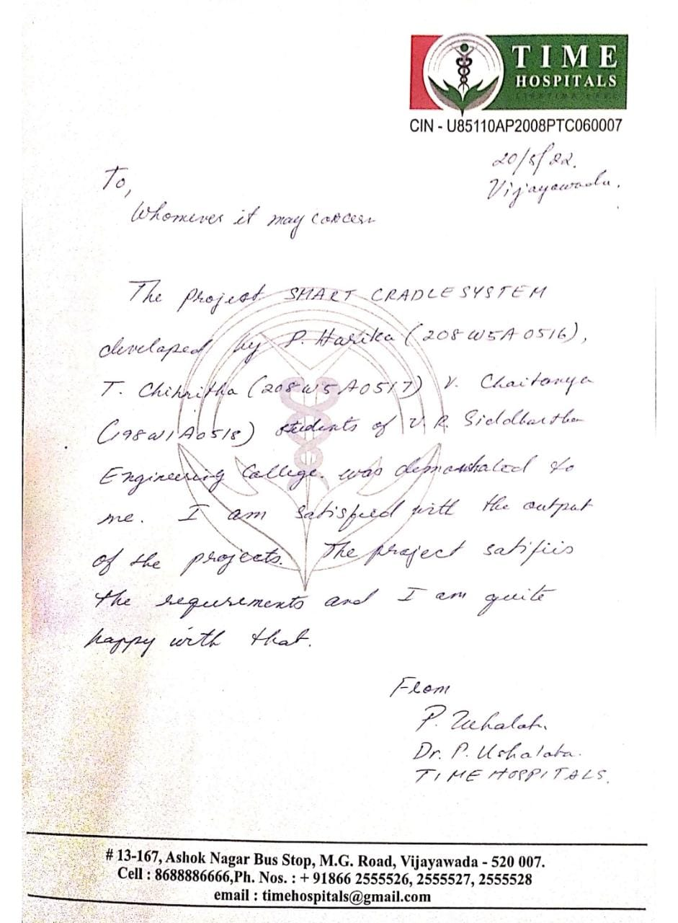
Client Satisfaction letter

Slide 22
Conclusion
As the technology is being increased, this smart cradle helps most employed women to give their babies a safe environment to sleep in when they are engaged in other work. This smart cradle provides continuous monitoring of the baby and if any uncertain conditions occur then it will notify the parent’s phone number and make calls if temperature and movement are detected. This cradle will be less costly and handy to use and also provides a comfortable place for the baby to sleep. The infant’s health is the major parameter that is to be always monitored This cradle will help the mothers to do their household work besides taking care of the baby at the same time using smart devices such as smart phones and laptops.
This system can be enhanced by developing an android application with the best interface, with which users can remotely operate the cradle and can be able to connect with the cloud.

Slide 23
References
[1] IoT -BBMS: Internet of Things-Based Baby Monitoring System for Smart Cradle, Institute of Electrical and Electronics Engineers(IEEE)-12 July 2019.
[2] Yeong Jun Jeon, Wearable Sleep care Kit: Analysis and Prevention of Sleep Apnea Symptoms in Real-Time, , Institute of Electrical and Electronics Engineers(IEEE) , March 2019.
[3] Riasat Khan ,Development of an IoT based Smart Baby Monitoring System with Face Recognition , Institute of Electrical and Electronics Engineers(IEEE),May 2021
[4] Muhammet Garip, An enhanced noise cancelling system for a comprehensive monitoring and control of baby environments, Institute of Electrical and Electronics Engineers(IEEE)- march 2015

Slide 24
References
[5] Nazia Hassan, Design and development of a smart baby monitoring system based on Raspberry Pi and Pi camera, Institute of Electrical and Electronics Engineers(IEEE) -January 2018
[6] Ali Ghazi Shabeeb, ,Central Real-time Monitoring System for Premature Baby Incubator, Institute of Electrical and Electronics Engineers(IEEE) - February 2021
[7] Abdurrahman Yılmaz, Rocking Motion of the Baby Sleeping on the Mother’s Lap: Modeling and Prototype Automatic Swing Cradle Design, Electric Electronics, Computer Science, Biomedical Engineerings' Meeting (EBBT)-
January-2017

Slide 25
THANK YOU

